Slide 1
The effects of voice stereotypes on voice parades
David Wright¹, Alice Paver², Natalie Braber¹
^{1 Nottingham Trent University}
^{2 University of Cambridge}

Slide 2
Voice parades
Witnesses who hear a perpetrator’s voice, but do not see their face, may be required to try and identify the perpetrator from a voice parade.
(Smith et al. 2019: 2)
During a voice parade the suspect is presented amongst “foil”, or distractor voices. If the “target” (i.e., perpetrator) is present the witness might identify the target voice (a hit) or a foil voice (a miss). Alternatively, they might incorrectly reject the parade by responding “not present”. If the target is absent the witness may incorrectly identify someone (a false alarm), despite having the option to respond, “not present”.
(Smith et al. 2022: 147)

Slide 3
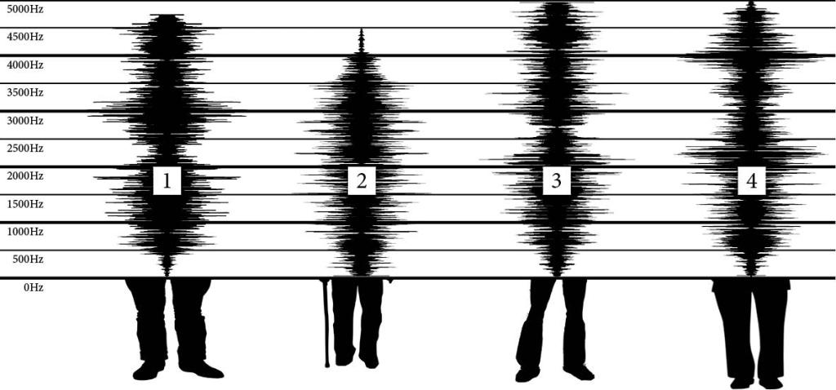
Voice parades
Home Office circular 057 / 2003
Advice on the use of voice identification parades

Slide 4
The IVIP Project
Improving Voice Identification Procedures
Strand 1
Establishing optimal parameter values for voice parade procedures
Strand 2
Exploring the psycho-phonetic underpinnings of voice distinctiveness
Strand 3
Investigating how social stereotypes affect voice identification
Strand 4
Examining the accuracy of criminal justice practitioners’ knowledge and beliefs with respect to voice identification procedures

Slide 5
The IVIP Project
Improving Voice Identification Procedures
Strand 1
Establishing optimal parameter values for voice parade procedures
Strand 2
Exploring the psycho-phonetic underpinnings of voice distinctiveness
Strand 3
Investigating how social stereotypes affect voice identification
Strand 4
Examining the accuracy of criminal justice practitioners’ knowledge and beliefs with respect to voice identification procedures

Slide 6
Stereotypes and voice parades
Strand 3
Experiment 1: accent
180 participants, 10 social traits, 10 behaviours (including criminal offences)
Listeners rated different accents have possessing, or not, different social traits
Listeners rated different accents as being more or less likely to behave in certain ways and commit certain criminal offences
Experiment 2: pitch and articulation rate
180 participants, 9 voices, 10 social traits, 10 behaviours (including criminal offences)
Listeners rated lower-pitched voices less positively for social traits
Listeners rated voices with lower articulation rates less negatively for social traits and for morally good behaviours and criminal behaviours.

Slide 7
Stereotypes and voice parades
Experiment 3: effects of these listener attitudes on voice parades

Slide 8
The IVIP Project
Improving Voice Identification Procedures
Strand 1
Establishing optimal parameter values for voice parade procedures
Strand 2
Exploring the psycho-phonetic underpinnings of voice distinctiveness
Strand 3
Investigating how social stereotypes affect voice identification
Strand 4
Examining the accuracy of criminal justice practitioners’ knowledge and beliefs with respect to voice identification procedures

Slide 9
The IVIP Project
Improving Voice Identification Procedures
Strand 1
Establishing optimal parameter values for voice parade procedures
Strand 2
Exploring the psycho-phonetic underpinnings of voice distinctiveness
Strand 3
Investigating how social stereotypes affect voice identification
Strand 4
Examining the accuracy of criminal justice practitioners’ knowledge and beliefs with respect to voice identification procedures

Slide 10
Stereotypes and voice parades
Experiment 3: effects of these listener attitudes on voice parades
Research aim: to explore whether listener judgements, stereotypes and attitudes towards voices help account for their frequent incorrect selection in voice parades.
Hypothesis 1: voices that were most frequently selected from voice parades are rated by listeners more negatively in terms of social traits than those voices that were less frequently selected.
Hypothesis 2: voices that were most frequently selected from voice parades are rated by listeners more negatively in terms of behavioural traits (including criminality) than those voices that were less frequently selected.

Slide 11
Method
180 participants recruited through prolific
60 x DyVis parade (4 voices)
60 x WYRED parade (4 voices)
60 x YorVis parade (4 voices)
Stimuli, from Strand 1 Experiments:
3 different parades:
1 x DyVis (SSBE, Nolan et al., 2009);
1 x WYRED (West Yorkshire, (Gold et al., 2018);
1 x YorVis (York, McDougall et al. 2015)
4 voices from each parade:
Target voice (i.e. the ‘suspect’ voice)
1 x Most frequently selected voice by listeners
1 x Medium selected
1 x Least selected
7-point likert scale
10 x social traits: aggressive, confident, educated, friendly, honest, intelligent, kind, rich, trustworthy, working class
5 x behaviours: cheat on partner, return a wallet, stand up for someone, lie on CV, report a relative
5 x criminal offences: shoplift, dangerous driving, physical assault, sexual assault, vandalism

Slide 12
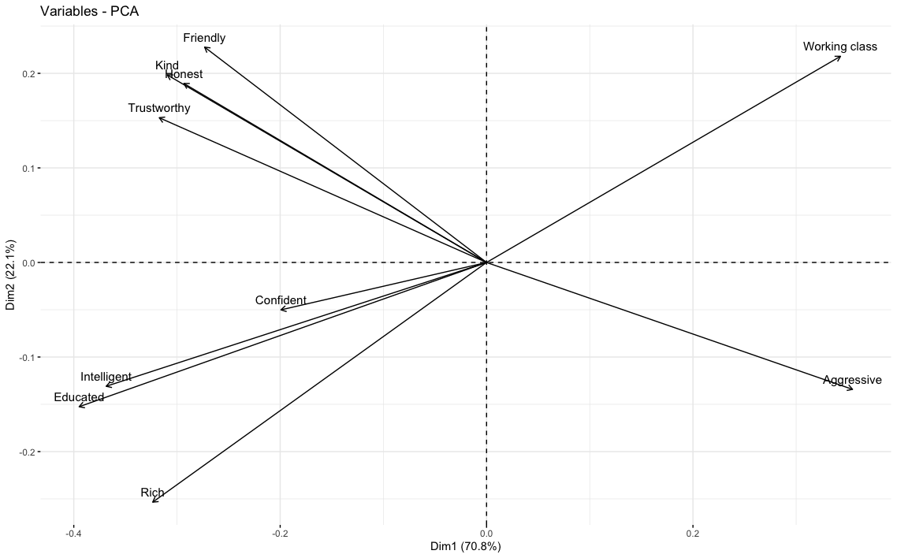
Social traits: question groupings
A – Solidarity/social attractiveness
B – Status/prestige
C – Confident
D – Working class
E - Aggressive

Slide 13
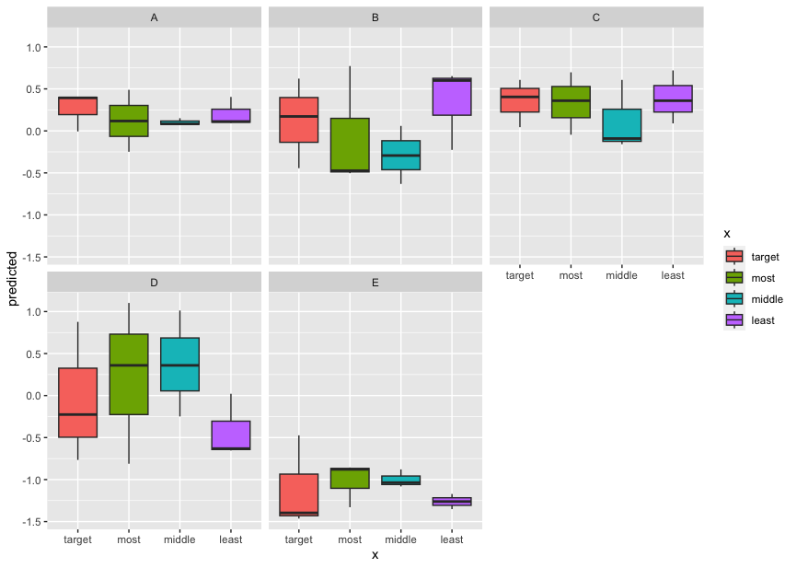
Social traits: results
Solidarity/social attractiveness
Status/prestige
Confidence
The most often incorrectly selected voice across all parades was rated lower on solidarity measures (i.e. to be less socially attractive) than the target voice
The most often incorrectly selected voice across all parades was rated lower on status measures (i.e. to be prestigious) than the target voice
The most often incorrectly selected voice across all parades was rated lower on confidence than the target voice
The most often incorrectly selected voice across all parades was rated higher on working class than the target voice
Working class
aggression

Slide 14
Stereotypes and voice parades
Experiment 3: effects of these listener attitudes on voice parades
Research aim: to explore whether listener judgements, stereotypes and attitudes towards voices help account for their frequent incorrect selection in voice parades.
Hypothesis 1: voices that were most frequently selected from voice parades are rated by listeners more negatively in terms of social traits than those voices that were less frequently selected.
Hypothesis 2: voices that were most frequently selected from voice parades are rated by listeners more negatively in terms of behavioural traits (including criminality) than those voices that were less frequently selected.

Slide 15
Stereotypes and voice parades
Experiment 3: effects of these listener attitudes on voice parades
Research aim: to explore whether listener judgements, stereotypes and attitudes towards voices help account for their frequent incorrect selection in voice parades.
Hypothesis 1: voices that were most frequently selected from voice parades are rated by listeners more negatively in terms of social traits than those voices that were less frequently selected.
Hypothesis 2: voices that were most frequently selected from voice parades are rated by listeners more negatively in terms of behavioural traits (including criminality) than those voices that were less frequently selected.

Slide 16
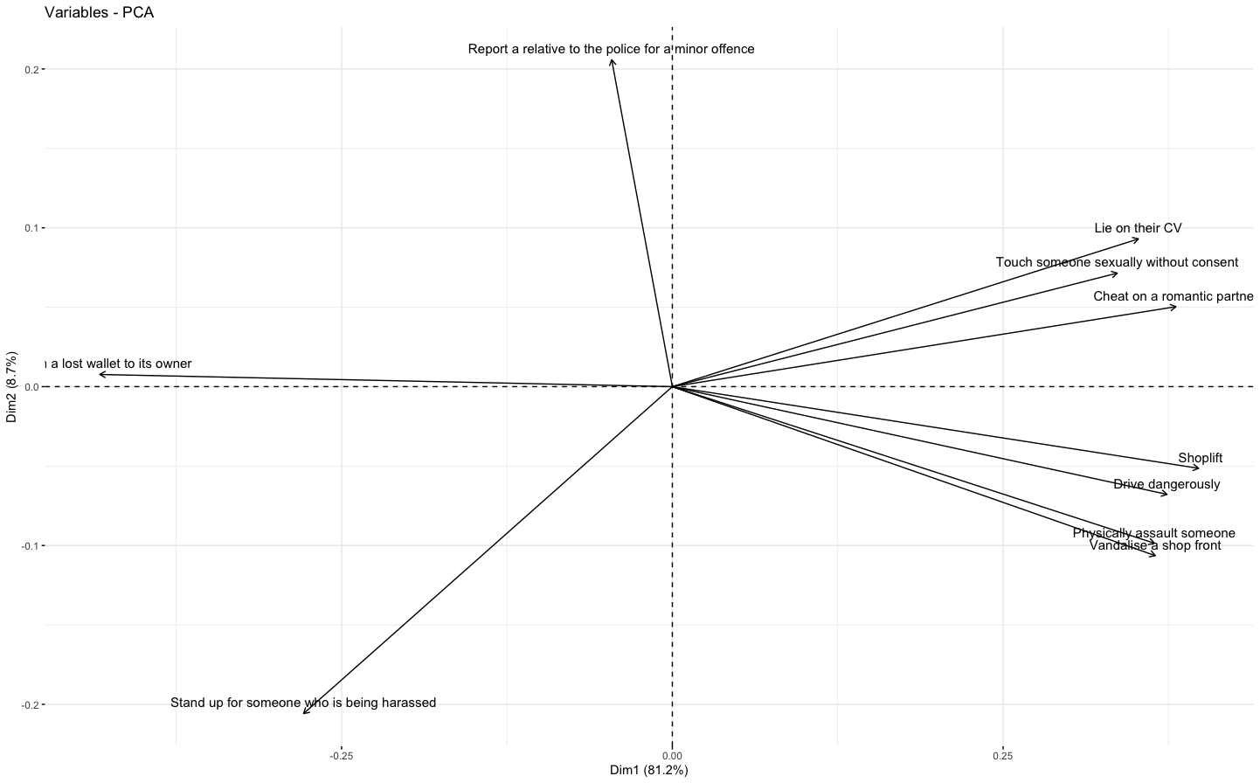
Behaviours: question groupings
A – Crimes
B – Intervening
C – Ethical
D – Morally ambiguous
E – Morally bad*

Slide 17
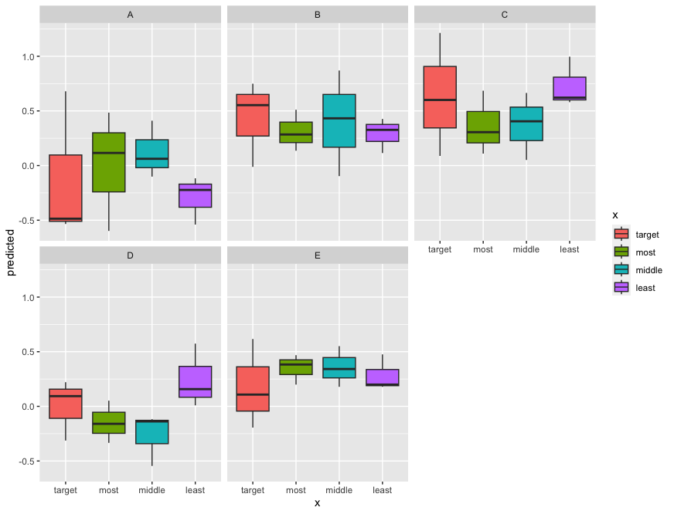
Behaviours: results
Crime
Intervening
Ethical
The most often incorrectly selected voice across all parades was judged more likely to commit criminal offences.
The most often incorrectly selected voice across all parades was rated less likely to stand up for someone being harassed.
The most often incorrectly selected voice across all parades was rated less likely to return a lost wallet.
The most often incorrectly selected voice across all parades was rated less likely to report a relative to the police.
Descriptively, the most selected voice was most associated with morally bad behaviours.
Morally ambiguous
Morally bad

Slide 18
Stereotypes and voice parades
Experiment 3: effects of these listener attitudes on voice parades
Research aim: to explore whether listener judgements, stereotypes and attitudes towards voices help account for their frequent incorrect selection in voice parades.
Hypothesis 1: voices that were most frequently selected from voice parades are rated by listeners more negatively in terms of social traits than those voices that were less frequently selected.
Hypothesis 2: voices that were most frequently selected from voice parades are rated by listeners more negatively in terms of behavioural traits (including criminality) than those voices that were less frequently selected.

Slide 19
Stereotypes and voice parades
Experiment 3: effects of these listener attitudes on voice parades
Research aim: to explore whether listener judgements, stereotypes and attitudes towards voices help account for their frequent incorrect selection in voice parades.
Hypothesis 1: voices that were most frequently selected from voice parades are rated by listeners more negatively in terms of social traits than those voices that were less frequently selected.
Hypothesis 2: voices that were most frequently selected from voice parades are rated by listeners more negatively in terms of behavioural traits (including criminality) than those voices that were less frequently selected.

Slide 20
Summary
In the Strand 1 experiments, listeners frequently selected the wrong voice from the voice parade.
It is likely that part of the reason for this is that listeners perceive a foil voice as being more similar to the target voice.
However, it also might also be the case that certain foil voices were chosen because listeners have more negative attitudes and judgements towards those voices than the others in the parade.
This poses a risk to the evidence obtained in voice parades.

Slide 21
Summary
Recommendations for Home Office guidelines:
Voices selected as foils should not be too similar to the target voice.
Those undertaking voice parades should implement a pre-test, based on the conditions of the experiment presented here, to identify whether any of the foil or suspect voices are judged particularly negatively or ‘guilty’.
Any foil voices that stand out should be excluded from the parade. If the suspect voice stands out, the running of a voice parade should be reconsidered.

Slide 22
References
Gold, E., Ross, S., Earnshaw, K. (2018) The ‘West Yorkshire Regional English Database’: Investigations into the Generalizability of Reference Populations for Forensic Speaker Comparison Casework. Proc. Interspeech 2018, 2748-2752, https://doi.org/10.21437/Interspeech.2018-65
Home Office (2003). Home Office circular 057/2003: Advice on the use of voice identification parades. http://webarchive.nationalarchives.gov.uk/20130308000037/http://www.homeoffice.gov.uk/about-us/corporate-publications-strategy/home-office-circulars/circulars2003/057-2003/
McDougall, K., M. Duckworth and T. Hudson (2015) ‘Individual and group variation in disfluency features: a cross-accent investigation.’ In: The Scottish Consortium for ICPhS 2015 (ed.) Proceedings of the 18th International Congress of Phonetic Sciences, 10-14 August 2015, Glasgow. Paper number 0308.,1–5. http://www.icphs.info/pdfs/Papers/ICPHS0308.pdf
Nolan, F., McDougall, K., de Jong, G., & Hudson, T. (2009). 'The DyViS database: style-controlled recordings of 100 homogeneous speakers for forensic phonetic research.' International Journal of Speech, Language and the Law 16.1: 31-57.
Smith, H.M.J., Roeser, J., Pautz, N., Davis, J.P., Robson, J., Wright, D., Braber, N. and Stacey, P.C. (2023) Evaluating earwitness identification procedures: adapting pre-parade instructions and parade procedure. Memory 31(1): 147–161.
Smith, H., Bird, K., Roeser, J., Robson, J., Braber, N., Wright, D., and Stacey, P. (2020). Voice parade procedures: investigating methods of optimising witness performance. Memory 28(1): 2–17

Slide 23
Thank you!
www.phonetics.mmll.cam.ac.uk/ivip
@ivipproject

